Slide 1
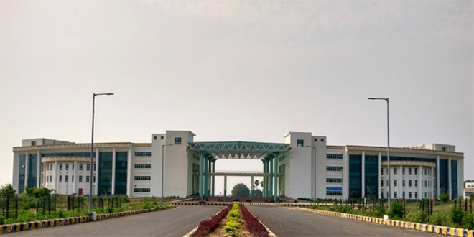

Spark GraphX & Graph Analytics
Dr. Rajiv Misra
Dept. of Computer Science & Engg.
Indian Institute of Technology Patna
rajivm@iitp.ac.in
Big Data Computing
GraphX

Slide 2
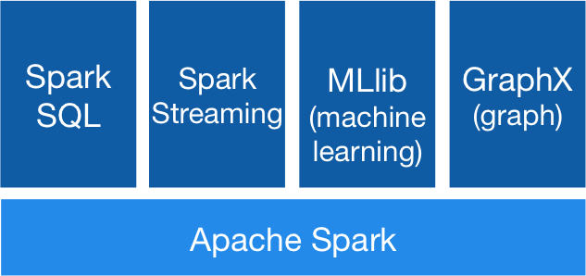
Preface
Content of this Lecture:
In this lecture, we will discuss GraphX: a distributed graph computation framework that unifies graph-parallel and data parallel computation for Big Data Analytics and also discuss as a case study of Graph Analytics with GraphX.
Big Data Computing
GraphX

Slide 3
Introduction
A piece of technology build on top of spark core.
Graphs like our social network of graphs in the computer science/network sense.
However, Graphs are only useful for specific things.
It can measure things like “connectedness”, degree distribution, average path length, triangle counts-high level measures of a graph.
It can count triangles in the graph, and apply the PageRank algorithm to it.
It can also join graphs together and transform graphs quickly
It supports the Pregel API( google) for traversing a graph.
Introduces VertexRDD and EdgeRDD, and the Edge data type .
Big Data Computing

Slide 4
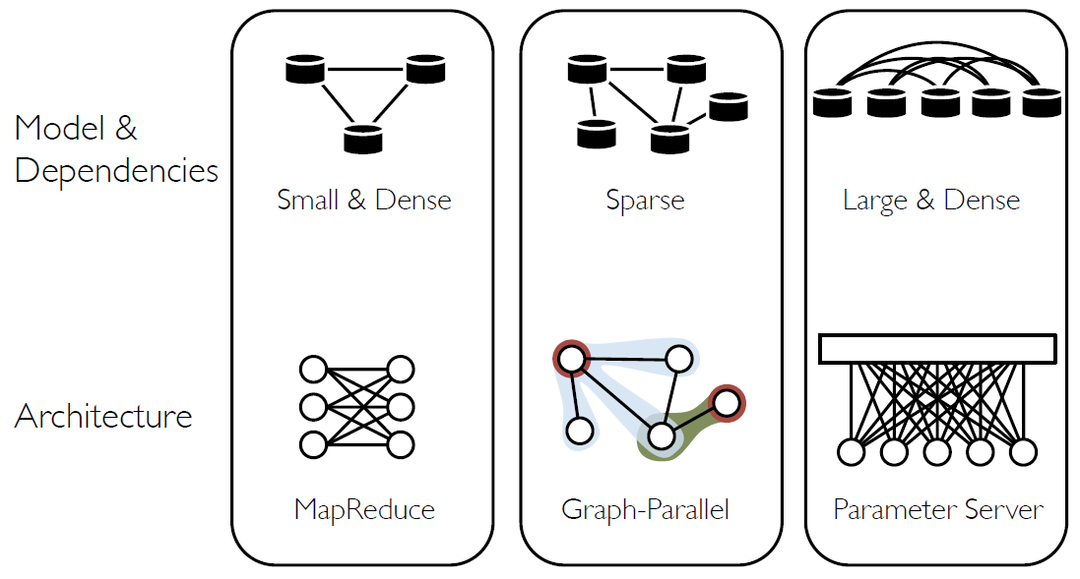
Graphs in Machine Learning Landscape
Big Data Computing
GraphX

Slide 5
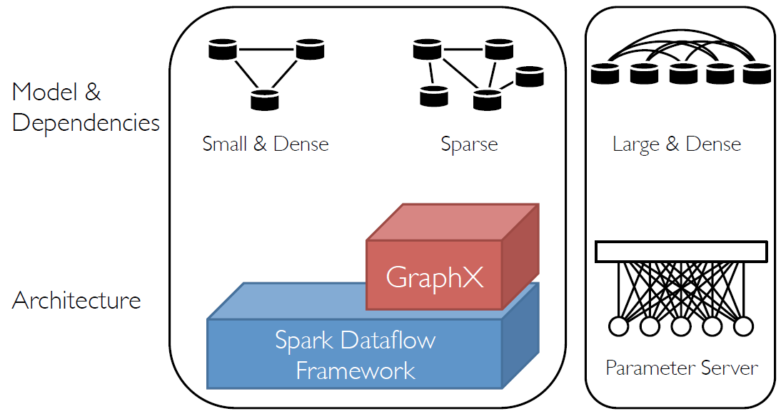
Machine Learning Landscape
Big Data Computing
GraphX

Slide 6
Graphs
Big Data Computing
GraphX

Slide 7
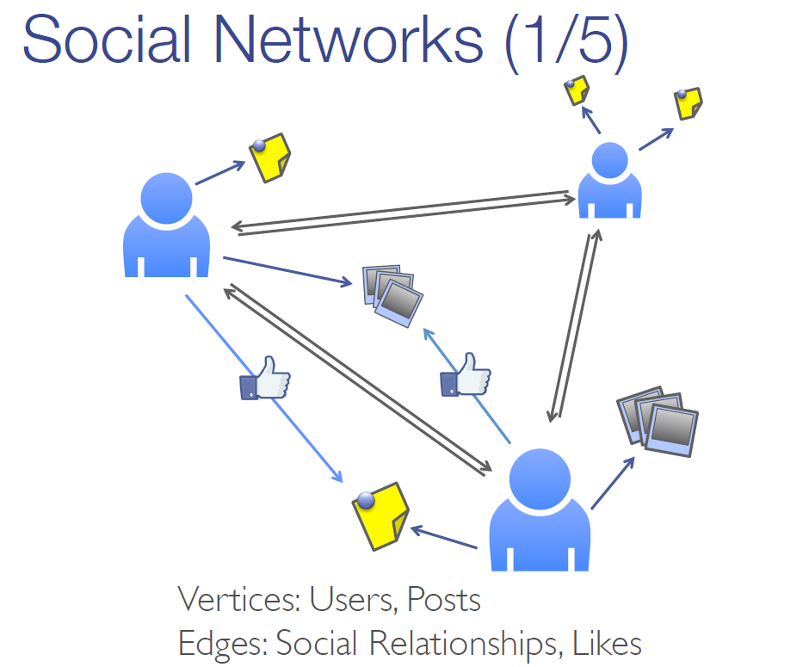
Graph-structured data is everywhere
Big Data Computing
GraphX

Slide 8
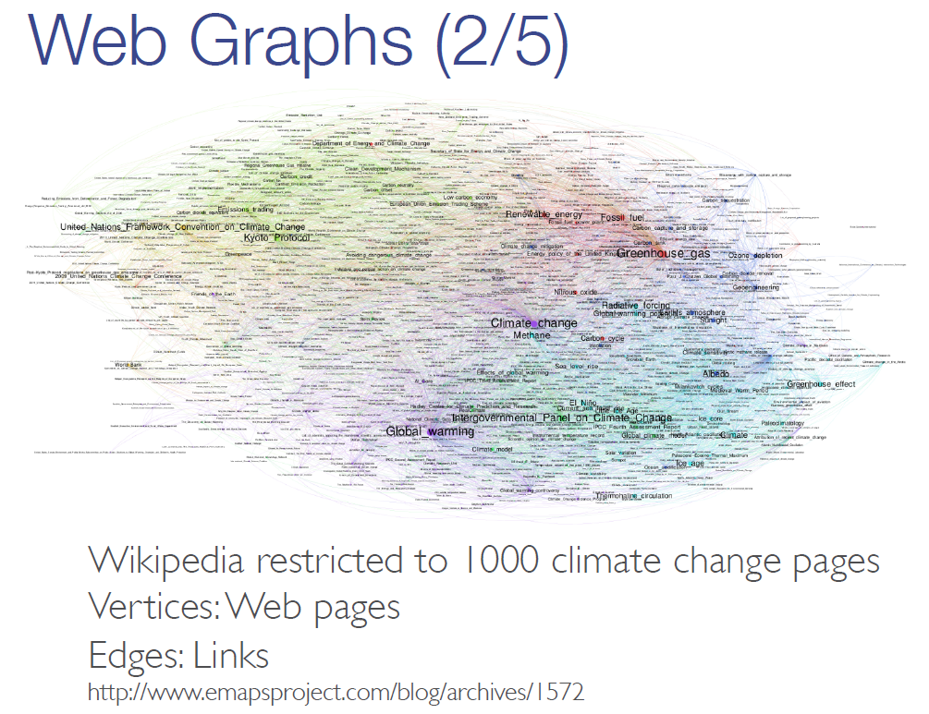
Graph-structured data is everywhere
Big Data Computing
GraphX

Slide 9
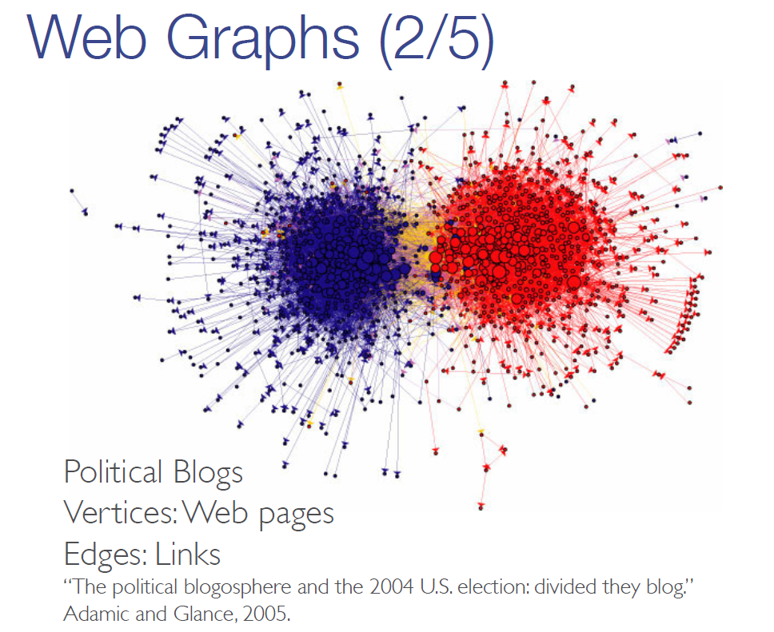
Graph-structured data is everywhere
Big Data Computing
GraphX

Slide 10
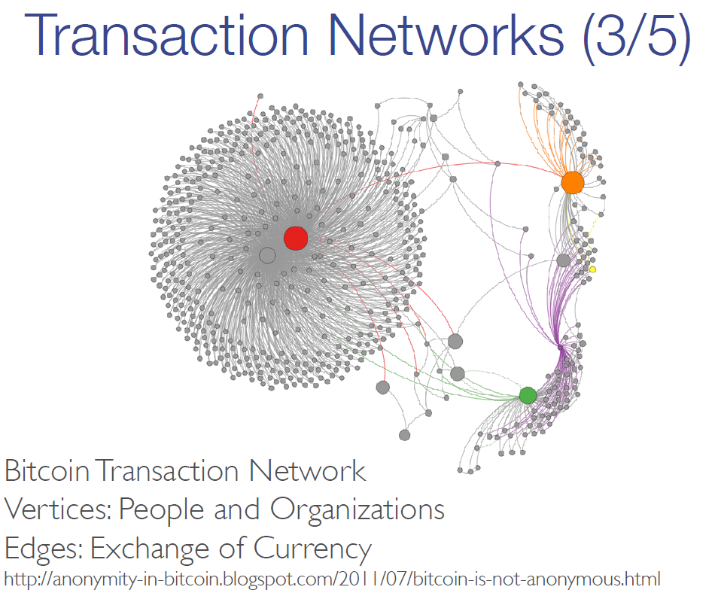
Graph-structured data is everywhere
Big Data Computing
GraphX

Slide 11
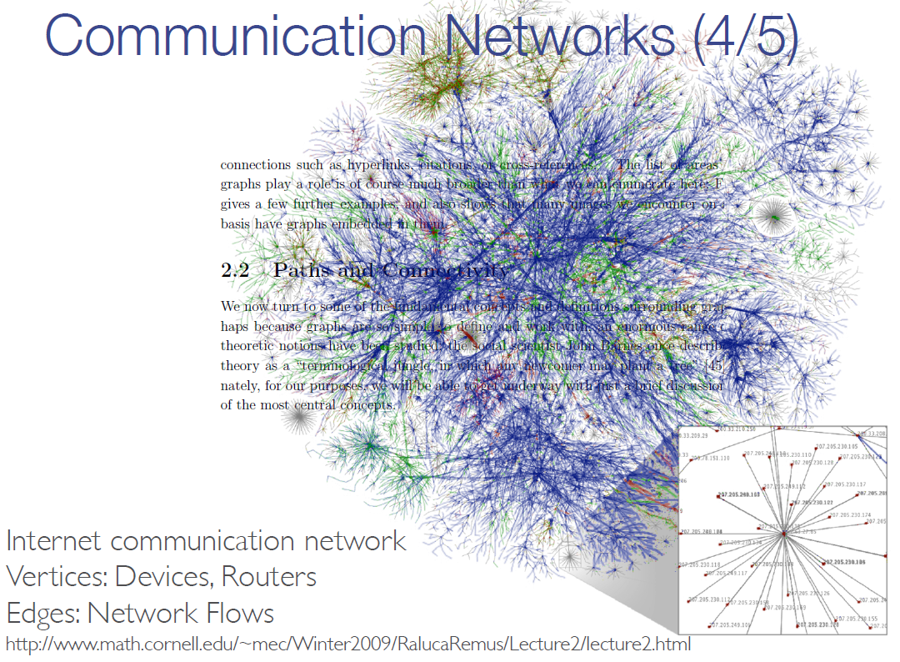
Graph-structured data is everywhere
Big Data Computing
GraphX

Slide 12
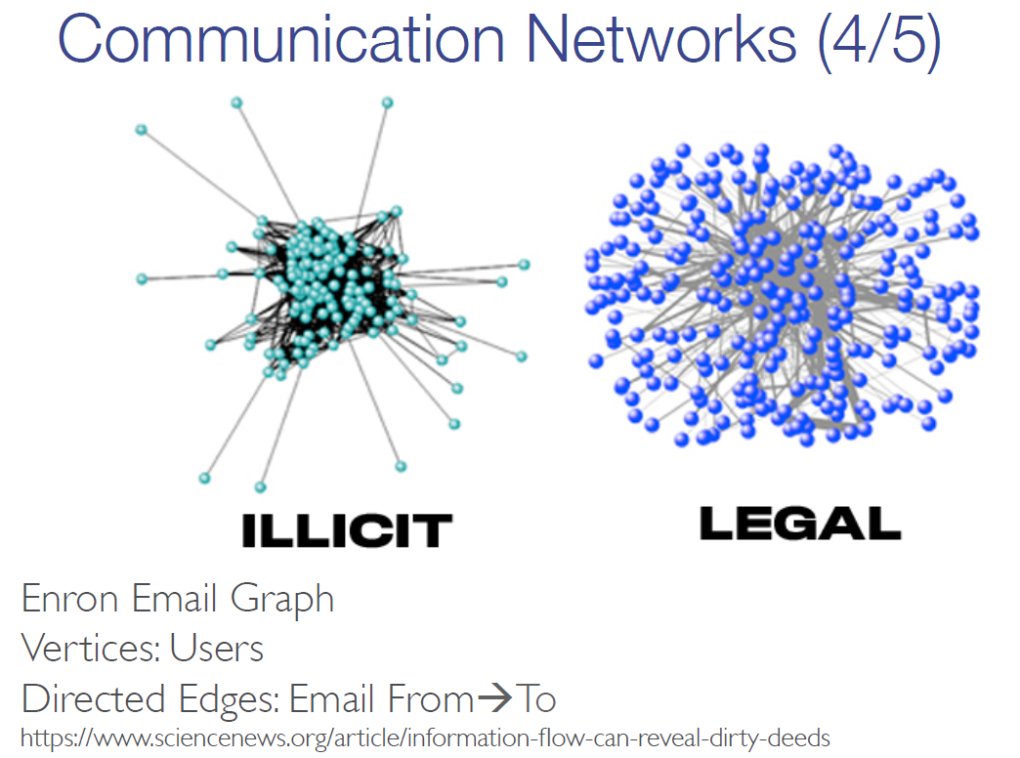
Graph-structured data is everywhere
Big Data Computing
GraphX

Slide 13
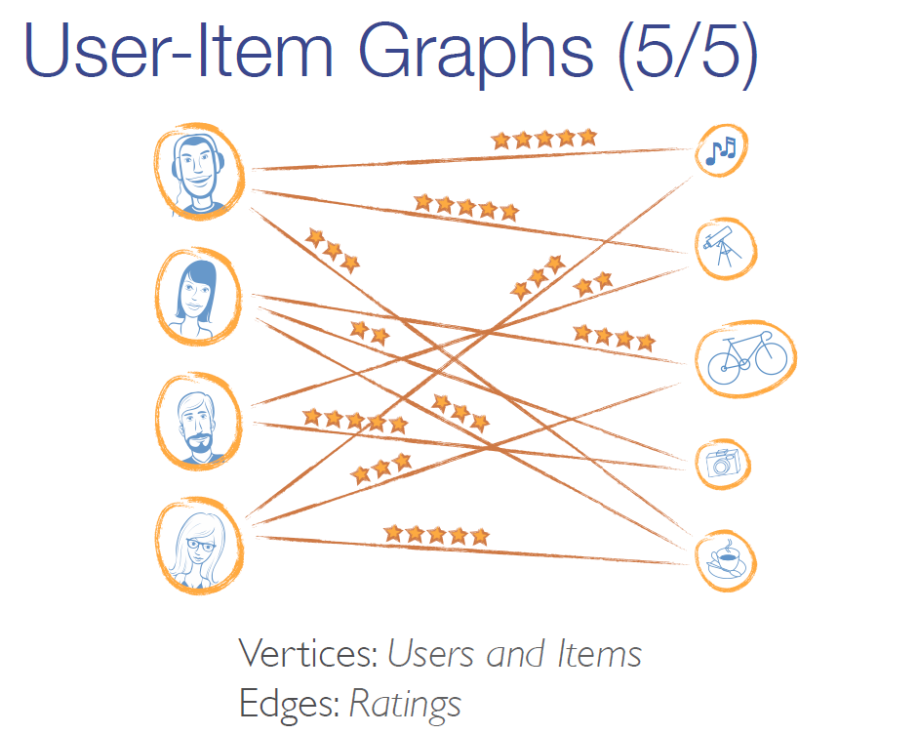
Graph-structured data is everywhere
Big Data Computing
GraphX

Slide 14
Graph Algorithms
Big Data Computing
GraphX

Slide 15
Graphs are Central to Analytics
Hyperlinks
PageRank
Top 20 Pages
Raw
Wikipedia
Text
Table
Title
PR
< / >
Title
Body
Term-Doc
Graph
Topic Model
(LDA)
< / >
< / >
Word Topics
XML
Word
Topic
Discussion
Table
Community
Detection
User
Community
Community
Topic
Editor Graph
User
Disc.
User
Com.
Topic
Com.

Slide 16
PageRank: Identifying Leaders
Rank of user i
Weighted sum of neighbors’ ranks
Update ranks in parallel
Iterate until convergence
Big Data Computing
GraphX

Slide 17
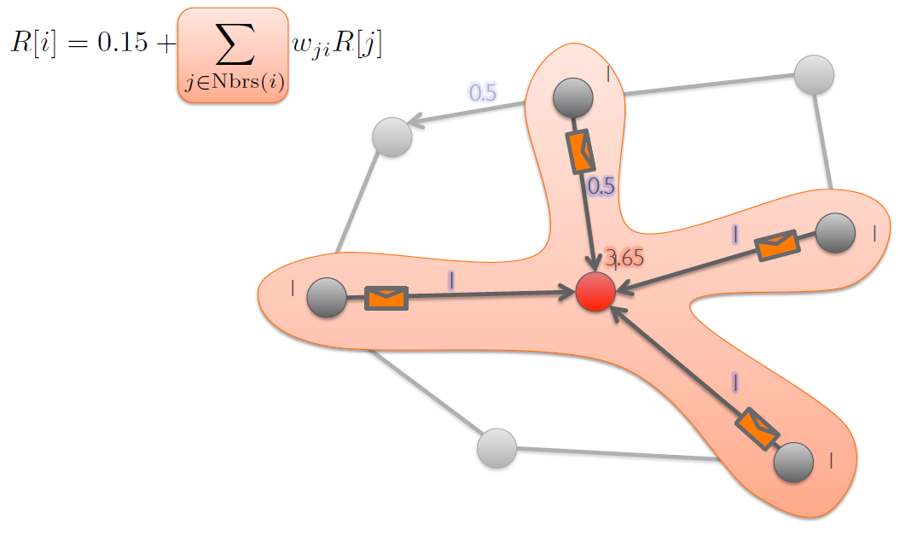
PageRank
Big Data Computing
GraphX

Slide 18
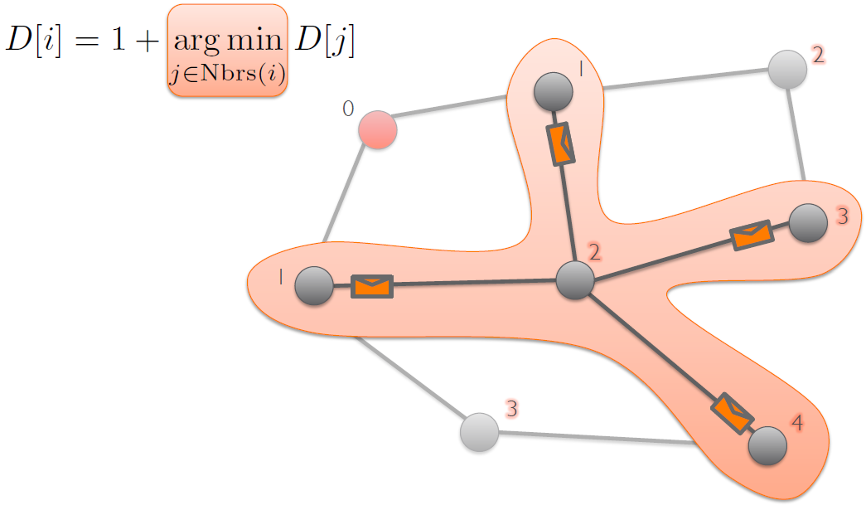
Single-Source Shortest Path
Big Data Computing
GraphX

Slide 19
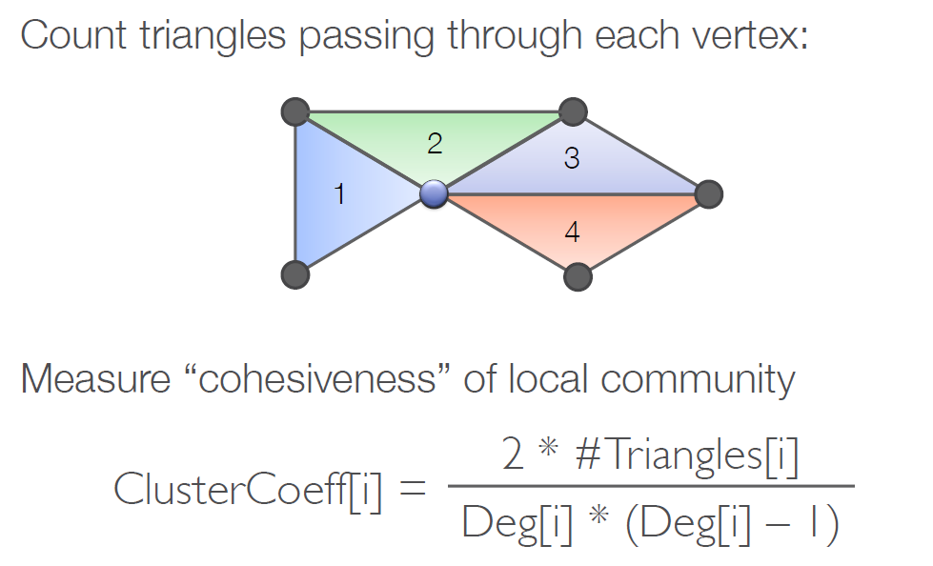
Finding Communities
Big Data Computing
GraphX

Slide 20
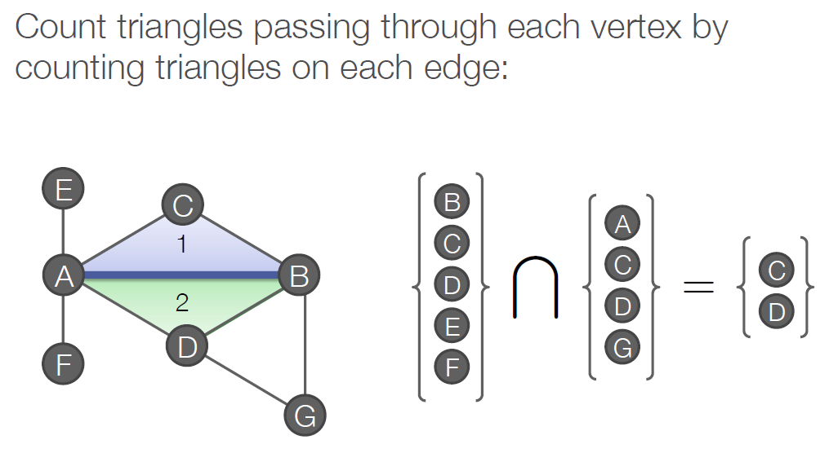
Counting Triangles
Big Data Computing
GraphX

Slide 21
The Graph-Parallel Pattern
Model / Alg.
State
Computation depends only on the neighbors
Big Data Computing
GraphX

Slide 22
Graph-Parallel Pattern
Gonzalez et al. [OSDI’12]
Gather information from neighboring vertices
Big Data Computing
GraphX

Slide 23
Graph-Parallel Pattern
Gonzalez et al. [OSDI’12]
Apply an update the
vertex property
Big Data Computing
GraphX

Slide 24
Graph-Parallel Pattern
Gonzalez et al. [OSDI’12]
Scatter information to neighboring vertices
Big Data Computing
GraphX

Slide 25
Many Graph-Parallel Algorithms
Collaborative Filtering
Alternating Least Squares
Stochastic Gradient Descent
Tensor Factorization
Structured Prediction
Loopy Belief Propagation
Max-Product Linear Programs
Gibbs Sampling
Semi-supervised ML
Graph SSL
CoEM
Community Detection
Triangle-Counting
K-core Decomposition
K-Truss
Graph Analytics
PageRank
Personalized PageRank
Shortest Path
Graph Coloring
Classification
Neural Networks
Big Data Computing
GraphX

Slide 26


Graph-Parallel Systems
Pregel
oogle
Expose specialized APIs to simplify graph programming.
Big Data Computing
GraphX

Slide 27
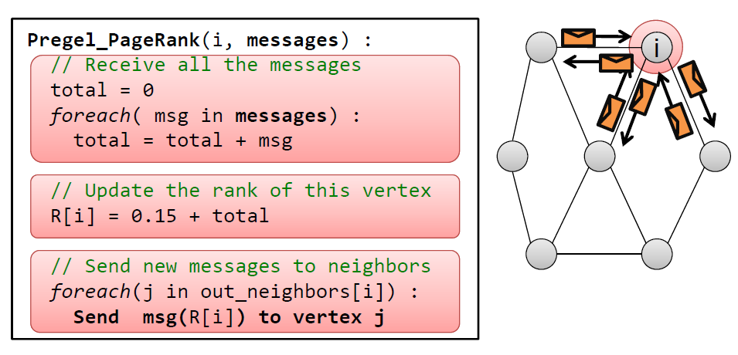
The Pregel (Push) Abstraction
“Think like a Vertex.” - Pregel [SIGMOD’10]
Vertex-Programs interact by sending messages.
Big Data Computing
GraphX

Slide 28
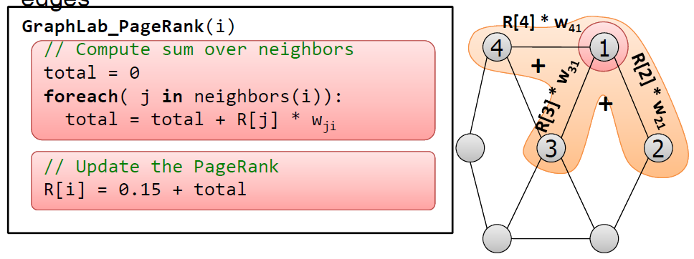
The GraphLab (Pull) Abstraction
Vertex Programs directly access adjacent vertices and edges
Data movement is managed by the system and not the user.
Big Data Computing
GraphX

Slide 29
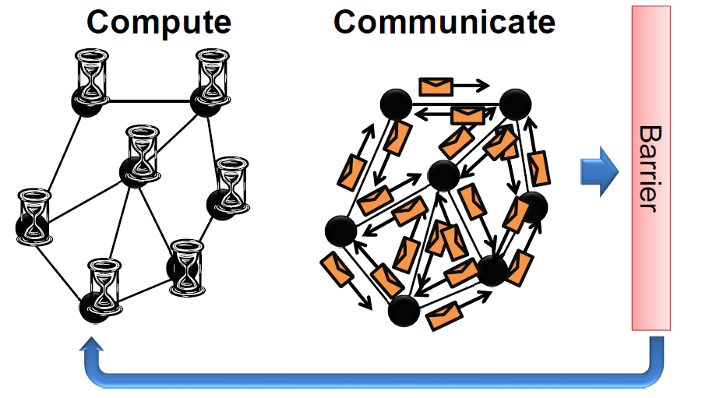
Iterative Bulk Synchronous Execution
Big Data Computing
GraphX

Slide 30
Graph-Parallel Systems
Pregel
oogle
Expose specialized APIs to simplify graph programming.
Exploit graph structure to achieve orders-of-magnitude performance gains over more general data-parallel systems.
Big Data Computing
GraphX

Slide 31
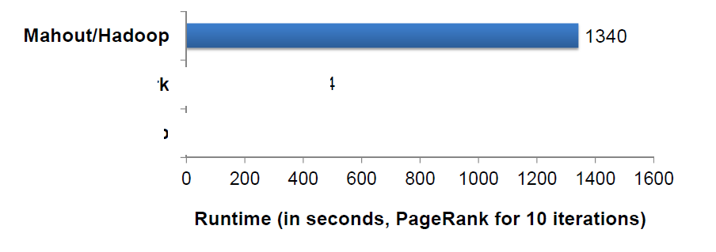
PageRank on the Live-Journal Graph
Spark is 4x faster than Hadoop
GraphLab is 16x faster than Spark
Big Data Computing
GraphX

Slide 32
PageRank on the Live-Journal Graph
GraphLab is 60x faster than Hadoop
GraphLab is 16x faster than Spark
Big Data Computing
GraphX

Slide 33
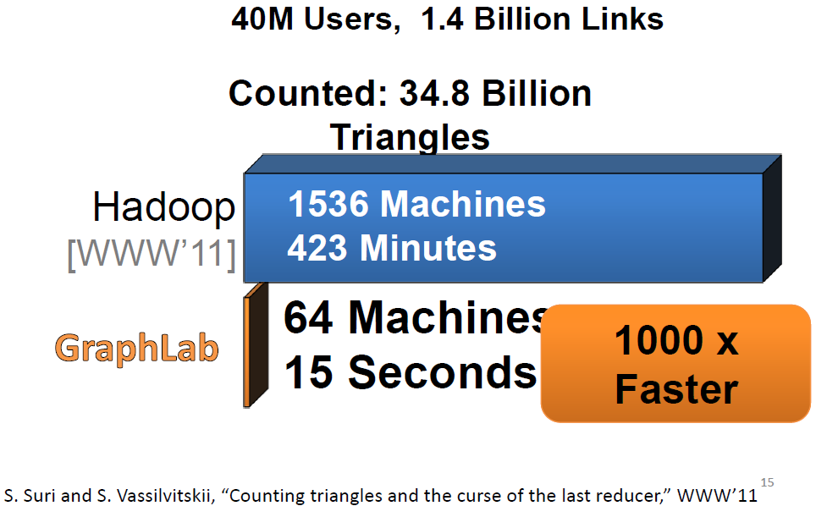
Triangle Counting on Twitter
Big Data Computing
GraphX

Slide 34
Graphs are Central to Analytics
Hyperlinks
PageRank
Top 20 Pages
Raw
Wikipedia
Text
Table
Title
PR
< / >
Title
Body
Term-Doc
Graph
Topic Model
(LDA)
< / >
< / >
Word Topics
XML
Word
Topic
Discussion
Table
Community
Detection
User
Community
Community
Topic
Editor Graph
User
Disc.
User
Com.
Topic
Com.

Slide 35



Separate Systems to Support Each View
Table View
Graph View
Pregel
Table
Dependency Graph
Row
Row
Result
Row
Row
Big Data Computing
GraphX
Notes:
----- Meeting Notes (1/5/14 14:58) -----
Spark too.

Slide 36
Having separate systems
for each view is
difficult to use and
inefficient
Big Data Computing
GraphX

Slide 37



Difficult to Program and Use
Users must Learn, Deploy, and Manage multiple systems
Leads to brittle and often complex interfaces
Big Data Computing
GraphX

Slide 38
Inefficient
Extensive data movement and duplication across the network and file system
< / >
< / >
< / >
XML
HDFS
HDFS
HDFS
HDFS
Limited reuse internal data-structures across stages
Big Data Computing
GraphX

Slide 39
Solution: The GraphX Unified Approach
New API
Blurs the distinction between Tables and Graphs
New System
Combines Data-Parallel Graph-Parallel Systems
Enabling users to easily and efficiently express the entire graph analytics pipeline
Big Data Computing
GraphX

Slide 40
Tables and Graphs are composable views of the same physical data
GraphX Unified
Representation
Table View
Graph View
Each view has its own operators that exploit the semantics of the view
to achieve efficient execution
Big Data Computing
GraphX
Notes:
and users can move between views without copying or moving data

Slide 41
Graphs → Relational Algebra
1. Encode graphs as distributed tables
2. Express graph computation in relational algebra
3. Recast graph systems optimizations as:
1. Distributed join optimization
2. Incremental materialized maintenance
Integrate Graph and
Table data
processing systems.
Achieve performance
parity with
specialized systems.
Big Data Computing
GraphX

Slide 42
View a Property Graph as a Table
Vertex Property Table
Property Graph
Id
Rxin
Jegonzal
Franklin
Istoica
Property (V)
(Stu., Berk.)
(PstDoc, Berk.)
(Prof., Berk)
(Prof., Berk)
R
F
Edge Property Table
SrcId | DstId
rxin | jegonzal
franklin | rxin
istoica | franklin
franklin | jegonzal
Property (E)
Friend
Advisor
Coworker
PI
J
I
Big Data Computing
GraphX

Slide 43
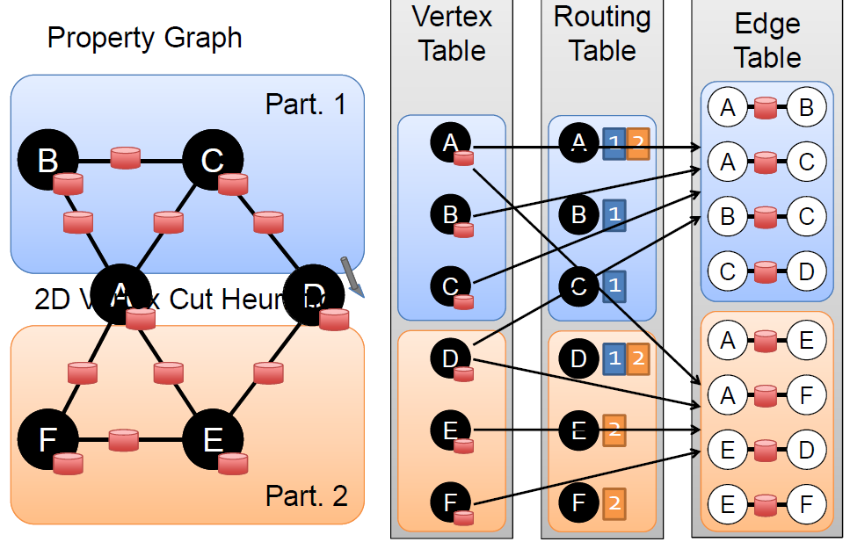
Property Graphs as Distributed Tables
Big Data Computing
GraphX

Slide 44
Table Operators
Table (RDD) operators are inherited from Spark:
map
filter
groupBy
sort
union
join
leftOuterJoin
rightOuterJoin
reduce
count
fold
reduceByKey
groupByKey
cogroup
cross
zip
sample
take
first
partitionBy
mapWith
pipe
save
...
Big Data Computing
GraphX

Slide 45
Graph Operators
class Graph [ V, E ] {
def Graph(vertices: Table[ (Id, V) ],
edges: Table[ (Id, Id, E) ])
// Table Views -----------------
def vertices: Table[ (Id, V) ]
def edges: Table[ (Id, Id, E) ]
def triplets: Table [ ((Id, V), (Id, V), E) ]
// Transformations ------------------------------
def reverse: Graph[V, E]
def subgraph(pV: (Id, V) => Boolean,
pE: Edge[V,E] => Boolean): Graph[V,E]
def mapV(m: (Id, V) => T ): Graph[T,E]
def mapE(m: Edge[V,E] => T ): Graph[V,T]
// Joins ----------------------------------------
def joinV(tbl: Table [(Id, T)]): Graph[(V, T), E ]
def joinE(tbl: Table [(Id, Id, T)]): Graph[V, (E, T)]
// Computation ----------------------------------
def mrTriplets(mapF: (Edge[V,E]) => List[(Id, T)], reduceF: (T, T) => T): Graph[T, E]
}
Big Data Computing
GraphX
Notes:
Make mrTriplets more visible.

Slide 46
Triplets Join Vertices and Edges
The triplets operator joins vertices and edges:
Vertices
Triplets
Edges
A
A
A
A
B
B
B
B
A
C
A
C
C
B
C
B
C
D
C
D
C
D
The mrTriplets operator sums adjacent triplets.
SELECT t.dstId, reduceUDF( mapUDF(t) ) AS sum
FROM triplets AS t GROUPBY t.dstId
Big Data Computing
GraphX
Notes:
w

Slide 47
Map Reduce Triplets
Map-Reduce for each vertex
B
C
mapF( )
A₁
A
B
A
mapF( )
A₂
A
C
D
E
reduceF( , )
A
A₁
A₂
F
Big Data Computing
GraphX

Slide 48
Example: Oldest Follower
What is the age of the oldest follower for each user?
val oldestFollowerAge = graph .mrTriplets( e=> (e.dst.id, e.src.age),//Map (a,b)=> max(a, b) //Reduce ) .vertices
23
42
B
C
30
A
D
19
E
75
F
16
Big Data Computing
GraphX

Slide 49
GraphX System Design
Big Data Computing
GraphX

Slide 50
Distributed Graphs as Tables (RDDs)
Vertex Table (RDD)
Routing
Table (RDD)
Edge Table
(RDD)
Property Graph
Part. 1
A
B
B
A
A
1
2
B
C
C
A
C
B
B
1
B
C
C
D
A
A
A
D
D
D
C
C
1
2D Vertex Cut Heuristic
A
D
Part. 2
A
E
D
D
1
2
A
F
F
F
E
E
E
E
2
E
D
F
F
2
E
F
Big Data Computing

Slide 51
Caching for Iterative mrTriplets
Vertex Table (RDD)
Edge Table
(RDD)
Mirror
Cache
A
B
A
A
A
A
A
C
B
B
B
B
C
C
D
C
D
C
C
Mirror
Cache
A
E
D
D
D
A
A
F
E
D
E
E
D
E
F
F
F
E
F

Slide 52
Incremental Updates for Iterative mrTriplets
Vertex Table (RDD)
Edge Table
(RDD)
Mirror
Cache
A
B
Change
A
A
A
A
A
C
B
B
B
C
C
D
C
D
C
Mirror
Cache
A
E
D
A
A
F
D
Change
E
Scan
E
E
D
E
F
F
E
F

Slide 53
Aggregation for Iterative mrTriplets
Vertex Table (RDD)
Edge Table
(RDD)
Mirror
Cache
A
B
Change
A
A
A
C
Local
Aggregate
B
B
Change
B
B
C
C
C
D
C
D
Change
C
Mirror
Cache
A
E
Change
D
A
A
F
Local
Aggregate
D
E
Scan
Change
D
E
D
E
Change
F
F
F
E
F

Slide 54
Reduction in Communication Due to Cached Updates
Most vertices are within 8 hops of all vertices in their comp.
Big Data Computing
GraphX

Slide 55
Benefit of Indexing Active Edges
Scan All Edges
Index of “Active” Edges
Big Data Computing
GraphX

Slide 56
Join Elimination
Identify and bypass joins for unused triplets fields
Example: PageRank only accesses source attribute
Factor of 2 reduction in communication
Big Data Computing
GraphX

Slide 57
Additional Query Optimizations
Indexing and Bitmaps:
To accelerate joins across graphs
To efficiently construct sub-graphs
Substantial Index and Data Reuse:
Reuse routing tables across graphs and sub-graphs
Reuse edge adjacency information and indices
Big Data Computing
GraphX
Notes:
Split Hash Table: reuse key sets across hash tables

Slide 58
Performance Comparisons
Live-Journal: 69 Million Edges
GraphX is roughly 3x slower than GraphLab
Big Data Computing
GraphX

Slide 59
GraphX scales to larger graphs
Twitter Graph: 1.5 Billion Edges
GraphX is roughly 2x slower than GraphLab
Scala + Java overhead: Lambdas, GC time, …
No shared memory parallelism: 2x increase in comm.
Big Data Computing
GraphX

Slide 60
A Small Pipeline in GraphX
Raw Wikipedia
Hyperlinks
PageRank
Top 20 Pages
< / >
< / >
< / >
HDFS
HDFS
XML
Spark Preprocess
Compute
Spark Post.
605
375
Timed end-to-end GraphX is faster than GraphLab
Big Data Computing
GraphX
Notes:
Also faster in human time but it is hard to measure.

Slide 61
The GraphX Stack (Lines of Code)
PageRank (5)
Connected Comp. (10)
Shortest Path (10)
SVD
(40)
ALS
(40)
K-core
(51)
Triangle
Count
(45)
LDA
(120)
Pregel (28) + GraphLab (50)
GraphX (3575)
Spark
Big Data Computing
GraphX

Slide 62
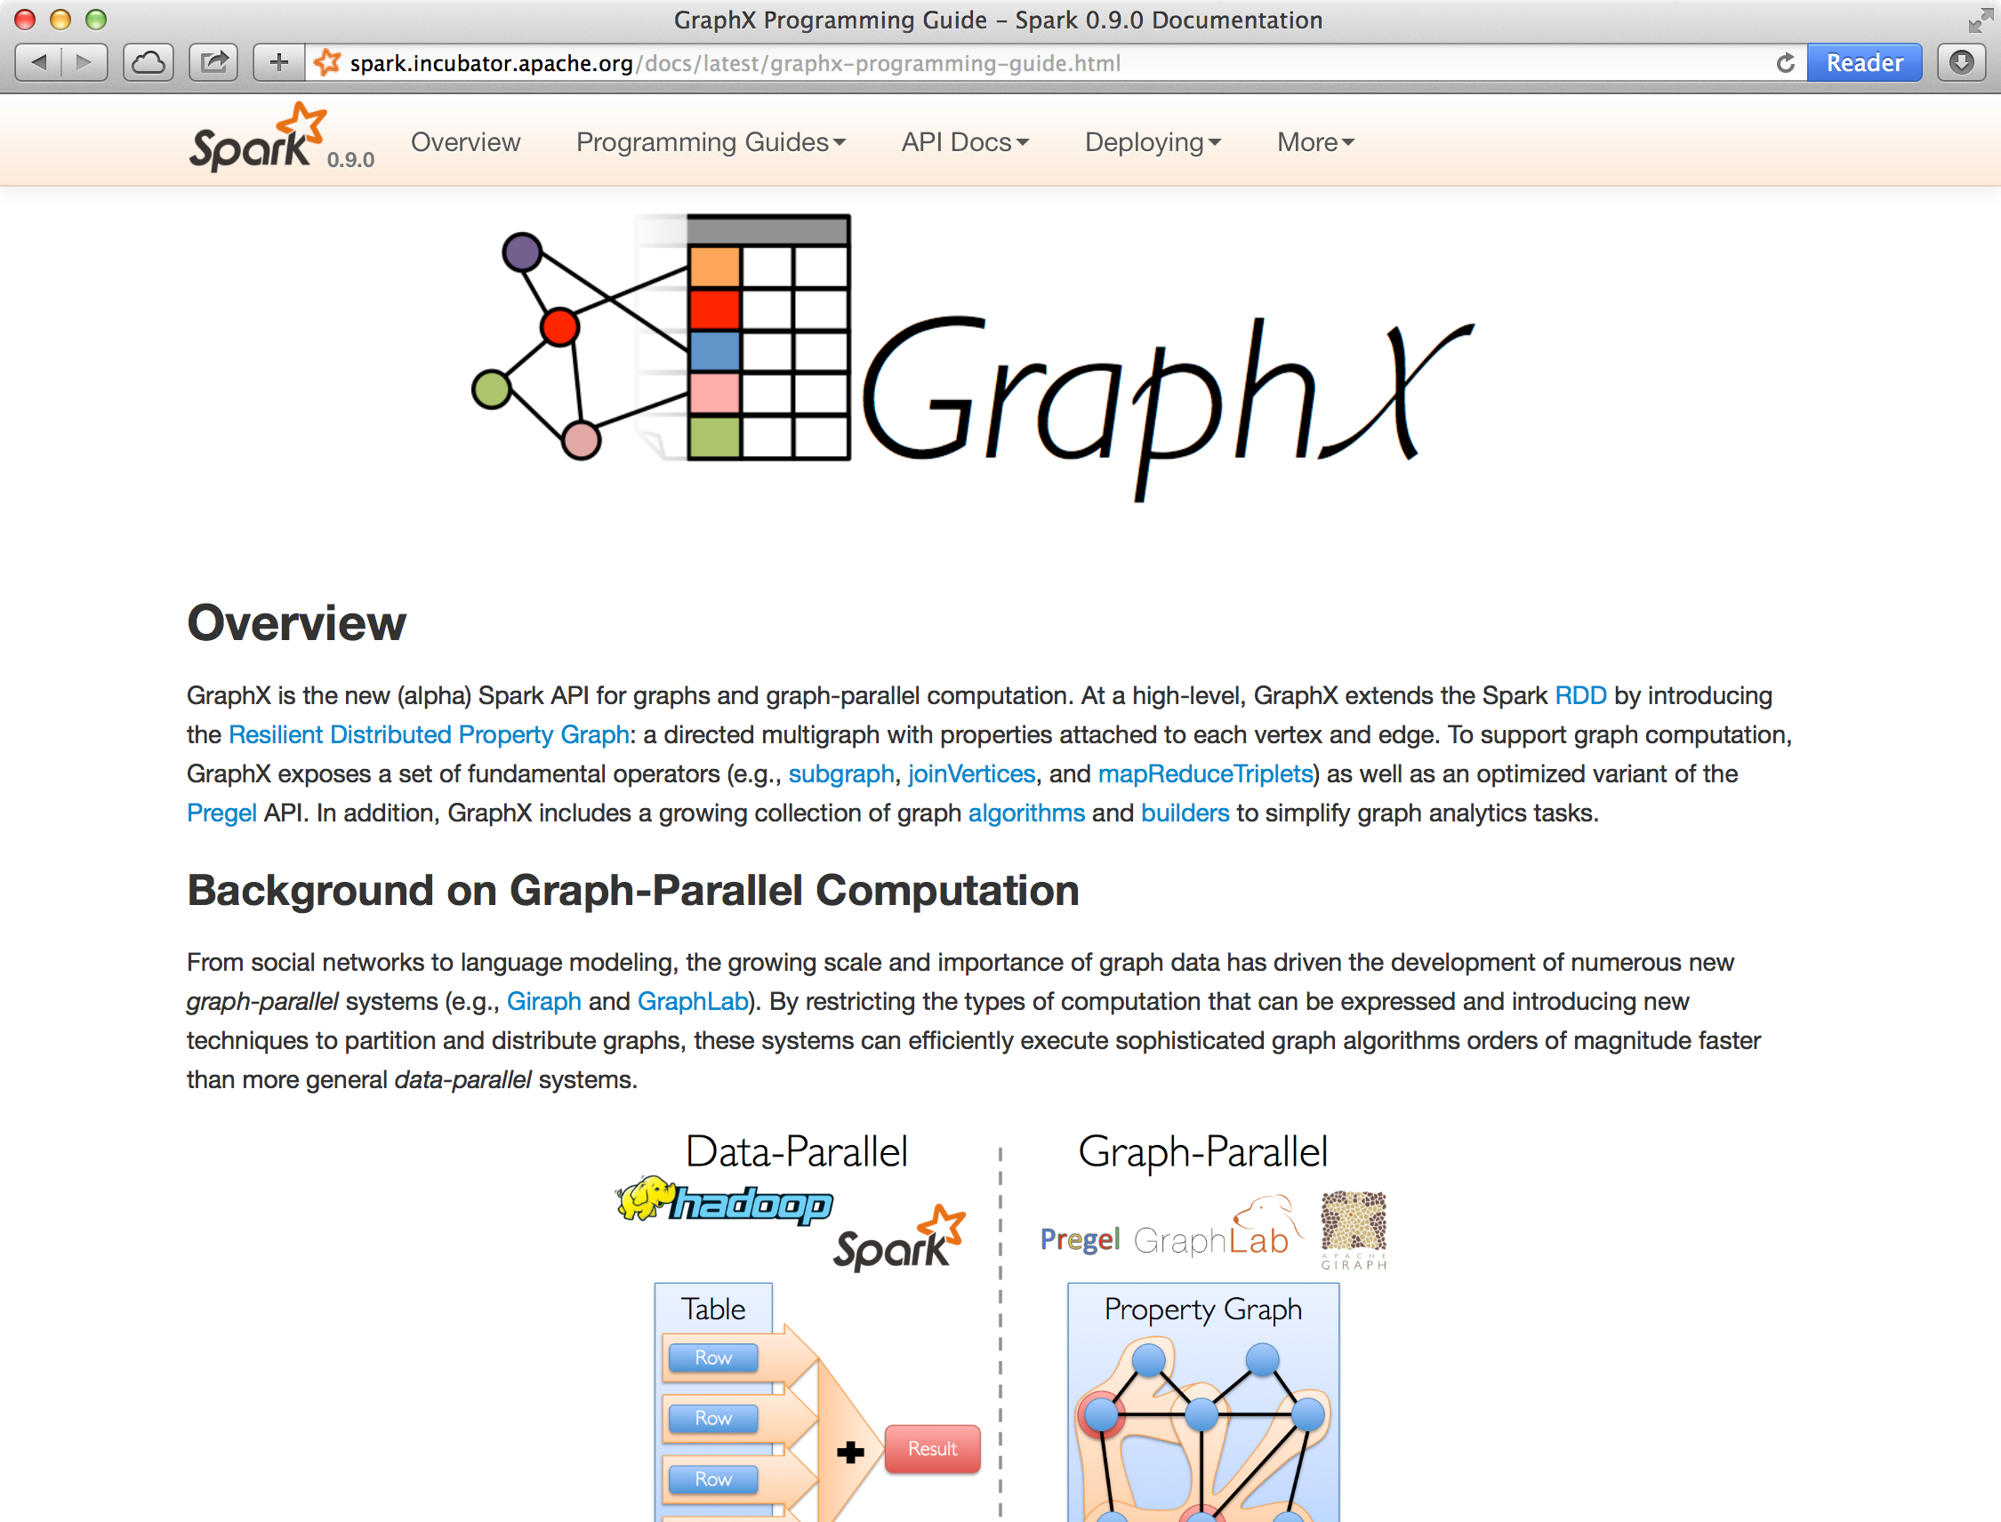
Status
Alpha release as part of Spark 0.9
Big Data Computing
GraphX

Slide 63
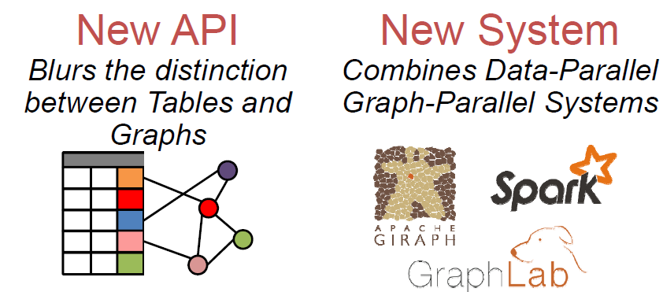
GraphX: Unified Analytics
Enabling users to easily and efficiently express the entire graph analytics pipeline
Big Data Computing
GraphX

Slide 64
A Case for Algebra in Graphs
A standard algebra is essential for graph systems:
e.g.: SQL → proliferation of relational system
By embedding graphs in relational algebra:
Integration with tables and preprocessing
Leverage advances in relational systems
Graph opt. recast to relational systems
Big Data Computing
GraphX

Slide 65
Observations
Domain specific views: Tables and Graphs
tables and graphs are first-class composable objects
specialized operators which exploit view semantics
Single system that efficiently spans the pipeline
minimize data movement and duplication
eliminates need to learn and manage multiple systems
Graphs through the lens of database systems
Graph-Parallel Pattern → Triplet joins in relational alg.
Graph Systems → Distributed join optimizations
Big Data Computing
GraphX

Slide 66
Active Research
Static Data → Dynamic Data
Apply GraphX unified approach to time evolving data
Model and analyze relationships over time
Serving Graph Structured Data
Allow external systems to interact with GraphX
Unify distributed graph databases with relational database technology
Big Data Computing
GraphX

Slide 67
Graph Property 1 Real-World Graphs
Power-Law Degree Distribution
Edges >> Vertices
AltaVista WebGraph1.4B Vertices, 6.6B Edges
More than 10⁸ vertices have one neighbor.
Top 1% of vertices are adjacent to
50% of the edges!
-Slope = α ≈ 2
Number of Vertices
Degree
Big Data Computing
GraphX

Slide 68
Graph Property 2 Active Vertices
PageRank on Web Graph
51% updated only once!
Big Data Computing
GraphX

Slide 69
Graphs are Essential to Data Mining and Machine Learning
Identify influential people and information
Find communities
Understand people’s shared interests
Model complex data dependencies
Big Data Computing
GraphX

Slide 70










Recommending Products
Users
Ratings
Items
Big Data Computing
GraphX

Slide 71
Recommending Products
Low-Rank Matrix Factorization:
f(3)
r₁₃
Movies
f(1)
Netflix
≈
x
Users
Users
f(j)
r₁₄
f(4)
f(i)
User Factors (U)
Movie Factors (M)
r₂₄
f(2)
Movies
r₂₅
f(5)
Iterate:
Big Data Computing
GraphX

Slide 72



Predicting User Behavior
?
?
Liberal
Conservative
?
?
?
?
?
?
?
?
Post
?
Post
?
Post
Post
?
Post
Post
Post
Post
?
Post
Post
Post
Post
?
Post
?
Post
?
?
?
?
?
Post
?
Post
Post
Post
Conditional Random Field
Belief Propagation
Post
Post
Post
?
Post
?
?
?
?
?
?
?
Big Data Computing
GraphX

Slide 73
Finding Communities
Count triangles passing through each vertex:
Measures “cohesiveness” of local community
2
3
1
4
Fewer Triangles
Weaker Community
More Triangles
Stronger Community
Big Data Computing
GraphX

Slide 74
Example Graph Analytics Pipeline
Preprocessing
Compute
Post Proc.
< / >
< / >
< / >
XML
Raw
Data
ETL
Slice
Compute
Analyze
Initial
Graph
Subgraph
PageRank
Top
Users
Repeat
Big Data Computing
GraphX

Slide 75
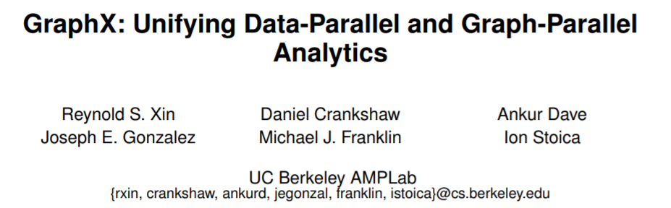
References
Xin, R., Crankshaw, D., Dave, A., Gonzalez, J., Franklin, M.J., & Stoica, I. (2014). GraphX: Unifying Data-Parallel and Graph-Parallel Analytics. CoRR, abs/1402.2394.
http://spark.apache.org/graphx
Big Data Computing
GraphX

Slide 76
Case Study: Flight Data Analysis using Spark GraphX
Big Data Computing
GraphX

Slide 77
Problem Statement
To analyze Real-Time Flight data using Spark GraphX, provide near real-time computation results and visualize the results.
Big Data Computing
GraphX

Slide 78
Flight Data Analysis using Spark GraphX
Dataset Description:
The data has been collected from U.S. Department of Transportation's (DOT) Bureau of Transportation Statistics site which tracks the on-time performance of domestic flights operated by large air carriers. The Summary information on the number of on-time, delayed, canceled, and diverted flights is published in DOT's monthly Air Travel Consumer Report and in this dataset of January 2014 flight delays and cancellations.
Big Data Computing
GraphX

Slide 79
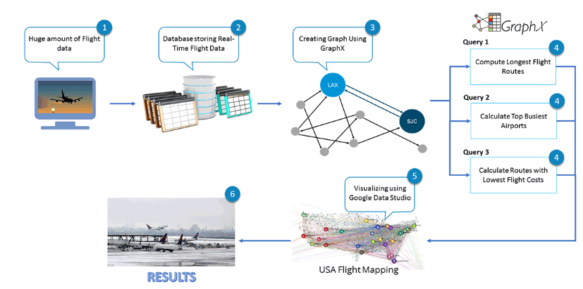
Big Data Pipeline for Flight Data Analysis using Spark GraphX
Big Data Computing
GraphX

Slide 80
UseCases
Monitoring Air traffic at airports
Monitoring of flight delays
Analysis overall routes and airports
Analysis of routes and airports per airline
Big Data Computing
GraphX

Slide 81
Objectives
Compute the total number of airports
Compute the total number of flight routes
Compute and sort the longest flight routes
Display the airports with the highest incoming flights
Display the airports with the highest outgoing flights
List the most important airports according to PageRank
List the routes with the lowest flight costs
Display the airport codes with the lowest flight costs
List the routes with airport codes which have the lowest flight costs
Big Data Computing
GraphX

Slide 82
Features
17 Attributes
Attribute Name | Attribute Description
dOfM | Day of Month
dOfW | Day of Week
carrier | Unique Airline Carrier Code
tailNum | Tail Number
fNum | Flight Number Reporting Airline
origin_id | Origin Airport Id
origin | Origin Airport
dest_id | Destination Airport Id
dest | Destination Airport
crsdepttime | CRS Departure Time (local time: hhmm)
deptime | Actual Departure Time
Big Data Computing
GraphX

Slide 83
Features
Attribute Name | Attribute Description
depdelaymins | Difference in minutes between scheduled and actual departure time. Early departures set to 0.
crsarrtime | CRS Arrival Time (local time: hhmm)
arrtime | Actual Arrival Time (local time: hhmm)
arrdelaymins | Difference in minutes between scheduled and actual arrival time. Early arrivals set to 0.
crselapsedtime | CRS Elapsed Time of Flight, in Minutes
dist | Distance between airports (miles)
Big Data Computing
GraphX

Slide 84
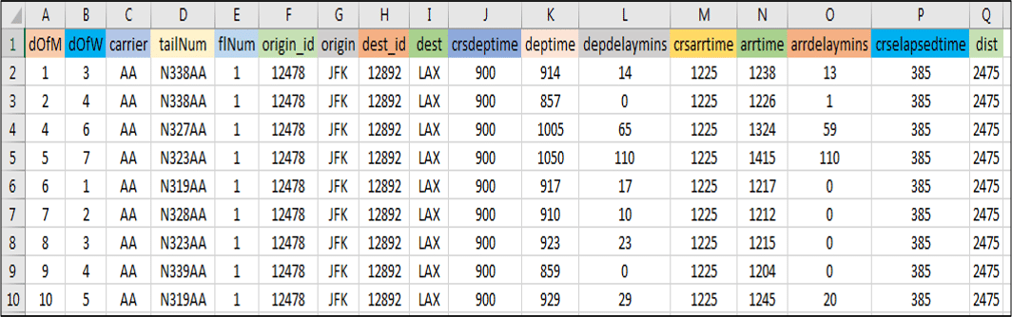
Sample Dataset
Big Data Computing
GraphX

Slide 85
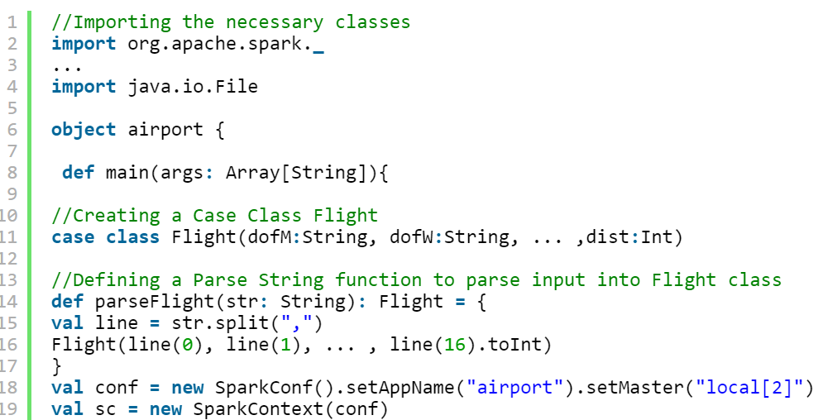
Spark Implementation
Big Data Computing
GraphX

Slide 86
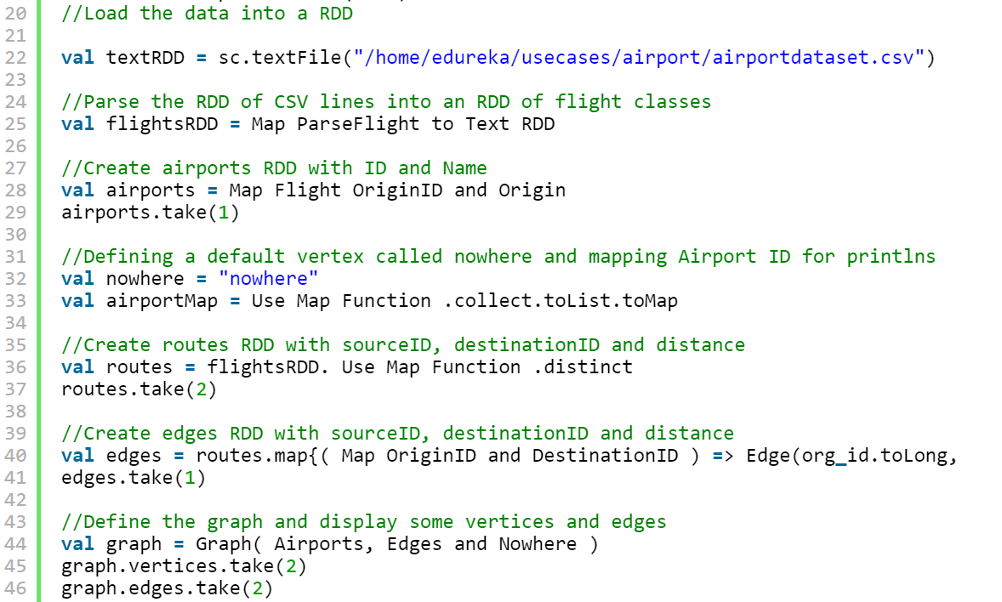
Spark Implementation
(“/home/iitp/spark-2.2.0-bin-hadoop-2.6/flights/airportdataset.csv")
Big Data Computing
GraphX

Slide 87
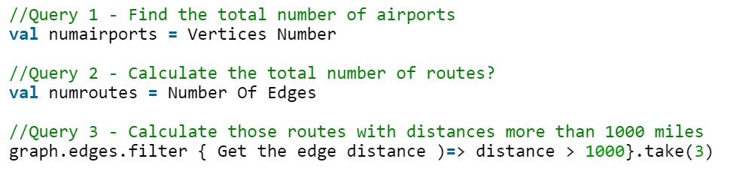
Graph Operations
Big Data Computing
GraphX

Slide 88
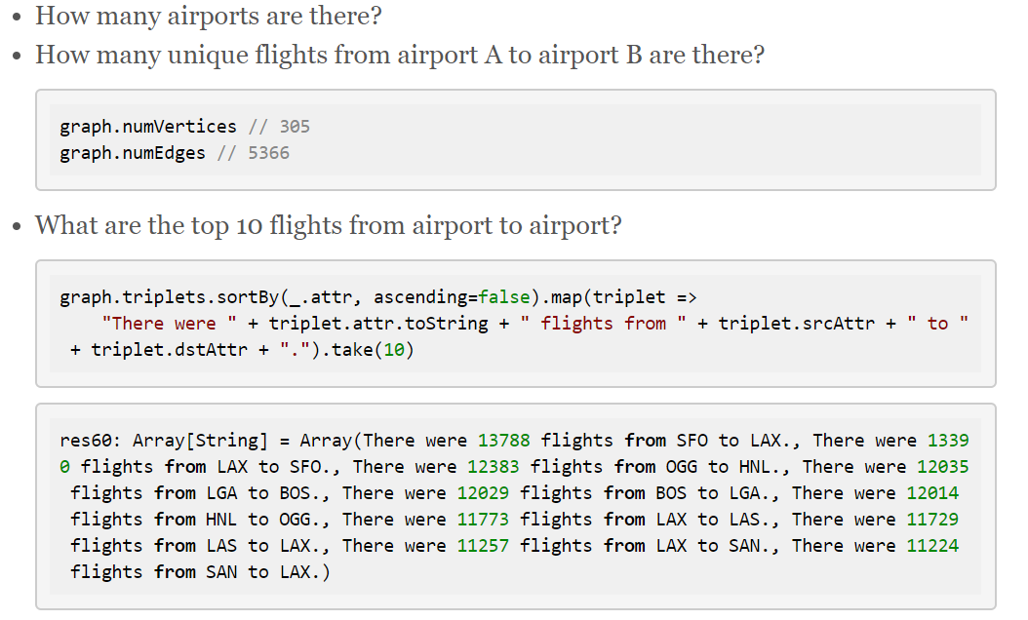
Graph Operations
Big Data Computing
GraphX

Slide 89
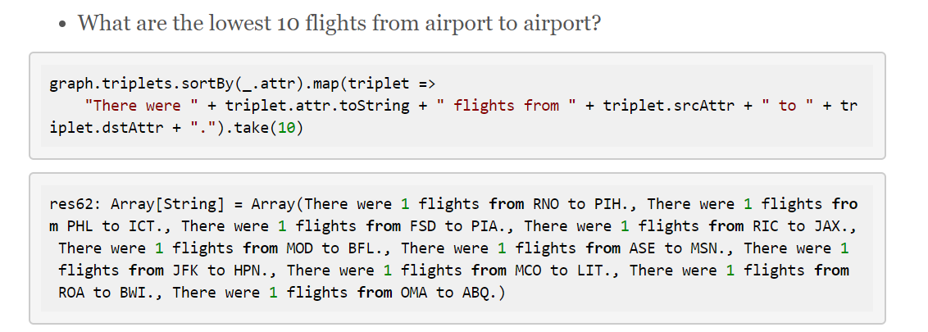
Graph Operations
Big Data Computing
GraphX

Slide 90
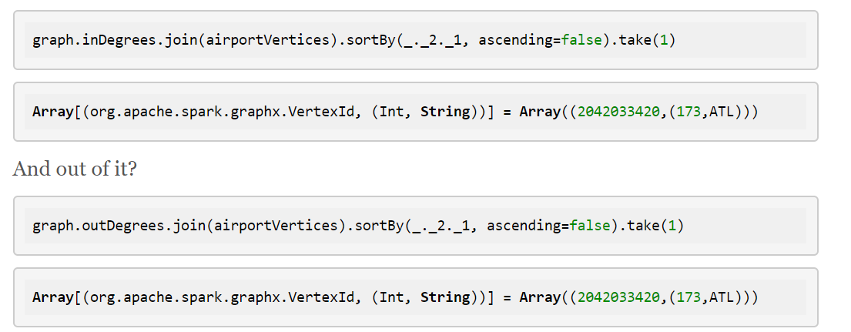
Graph Operations
what airport has the most in degrees or unique flights into it?
Big Data Computing
GraphX

Slide 91
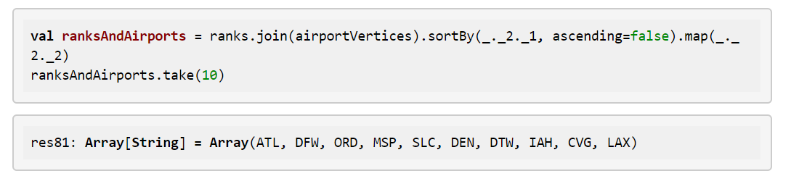
Graph Operations
What are our most important airports ?
Big Data Computing
GraphX

Slide 92
Graph Operations
Output the routes where the distance between airports exceeds 1000 miles
graph.edges.filter {
case (Edge(org_id, dest_id, distance)) => distance > 1000 }.take(5).foreach(println)
Big Data Computing
GraphX

Slide 93
Graph Operations
Output the airport with maximum incoming flight
// Define a reduce operation to compute the highest degree vertex
def max: (VertexId, Int), b: (VertexId, Int)): (VertexId, Int) = {
if (a._2 > b._2) a else b
}
// Compute the max degrees
val maxInDegree: (VertexId, Int) = graph.inDegrees.reduce(max)
Big Data Computing
GraphX

Slide 94
Graph Operations
Output the airports with maximum incoming flights
val maxIncoming=graph.inDegrees.collect.sortWith (_._2 > _._2).map(x => (airportMap(x._1), x._2)).take(10).foreach(println)
Big Data Computing
GraphX

Slide 95
Graph Operations
Output the longest routes
graph.triplets.sortBy(_.attr, ascending = false).map(triplet =>
"There were " + triplet.attr.toString + " flights from " + triplet.srcAttr + " to " + triplet.dstAttr + ".").take(20).foreach(println)
Big Data Computing
GraphX

Slide 96
Graph Operations
Output the cheapest airfare routes
val gg = graph.mapEdges(e => 50.toDouble + e.attr.toDouble / 20)
//Call pregel on graph
val sssp = initialGraph.pregel(Double.PositiveInfinity)(
//vertex program
(id, distCost, newDistCost) => math.min(distCost, newDistCost),triplet => {
//send message
if(triplet.srcAttr + triplet.attr < triplet.dstAttr)
{
Iterator((triplet.dstId, triplet.srcAttr + triplet.attr))
}
else
{
Iterator.empty
}
},
//Merge Messages
(a,b) => math.min(a,b)
)
//print routes with lowest flight cost
print("routes with lowest flight cost")
println(sssp.edges.take(10).mkString("\n"))
Big Data Computing
GraphX

Slide 97
Graph Operations (PageRank)
Output the most influential airports using PageRank
val rank = graph.pageRank(0.001).vertices
val temp = rank.join(airports)
temp.take(10).foreach(println)
Output the most influential airports from most influential to latest
val temp2 = temp.sortBy(_._2._1,false)
Big Data Computing
GraphX

Slide 98
Conclusion
The growing scale and importance of graph data has driven the development of specialized graph computation engines capable of inferring complex recursive properties of graph-structured data.
In this lecture we have discussed GraphX, a distributed graph processing framework that unifies graph-parallel and data-parallel computation in a single system and is capable of succinctly expressing and efficiently executing the entire graph analytics pipeline.
Big Data Computing
GraphX

